Slide 1
Drone Control Final Update
Adin Sacho-Tanzer and Gabriel Kret

Slide 2
Introduction
Aircraft dynamics simulators are helpful to test controllers without needing to run an expensive real-world test
Our goal: simulate an Aerosonde UAV accurately, including PID control, sensors and a Kalman filter
Then, implement the same simulation for a Cessna 172

Slide 3
Implementation
Used code structure from Beard
Rigid body class implements rigid body EOMs
Aircraft class implements aerodynamics, thrust, gravity, and wind
Trim conditions computed using Jacobians and minimize function
Added PID control
Tuned PID
Added sensors
Added Kalman filter
Changed all parameters to Cessna 172
Retuned PID for new plane
Retuned Kalman filter for new plane
Added automated takeoff, cruise, turn, descend

Slide 4
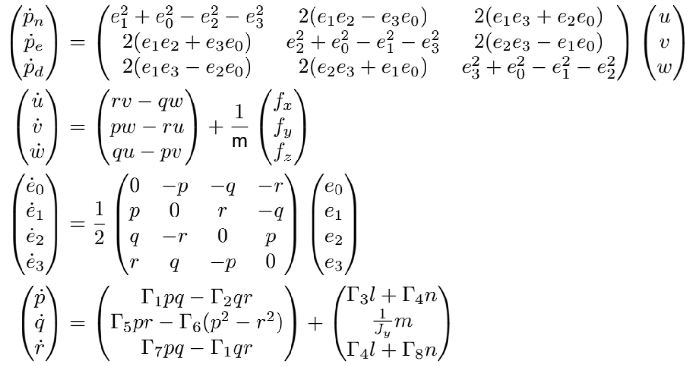
EOMs

Slide 5
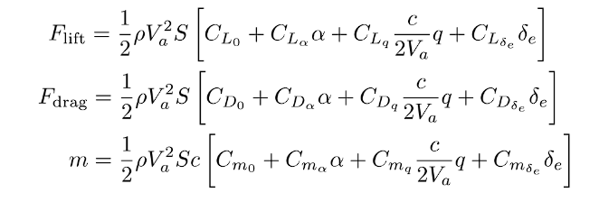
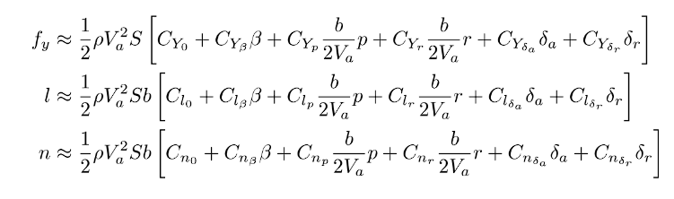
Linear Aerodynamic Model

Slide 6
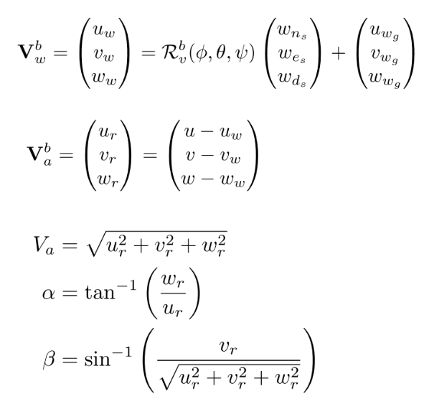
Wind

Slide 7
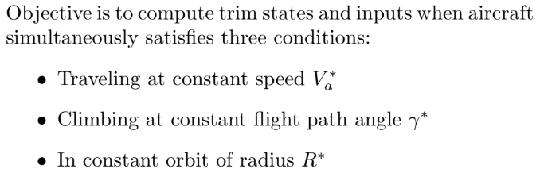
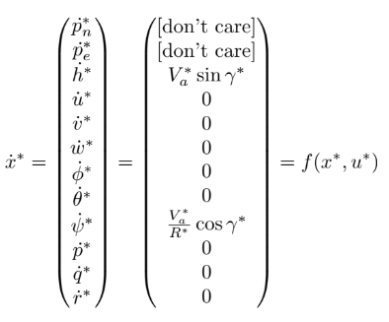


Trim Conditions
Goal: Converge to the trim objective function via minimization and enforcement of the trim constraints.
NOTE: when evaluating our state derivatives at trim conditions we expect all relevant results to be zero (see next slide). Our implementation achieved this except for q_dot which was non-zero.

Slide 8
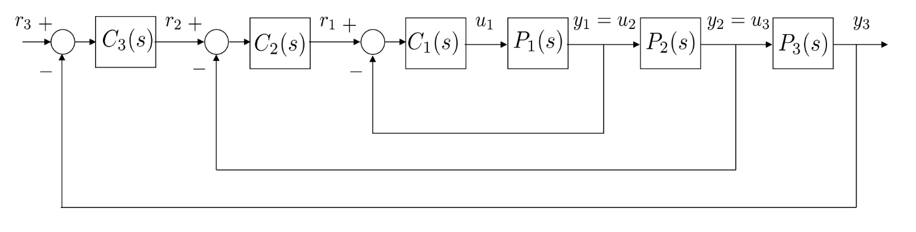
Implementing PID w/ Successive Loop Closure
SLC is a step-by-step method where you tune and close one control loop at a time, starting from the innermost loop, then moving outward, to keep the system stable and easier to control.
The inner loops then act as a DC gain on the outer loops.
The above loop is generic. We implement the above controller in the Autopilot class for both lateral and longitudinal control.
We can then tune the gains appropriately to achieve satisfactory flight dynamics.

Slide 9
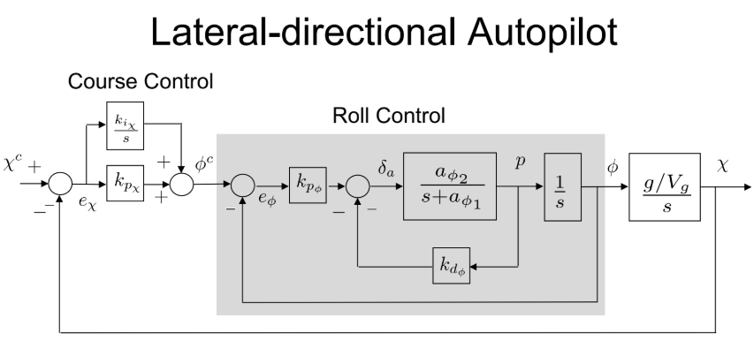
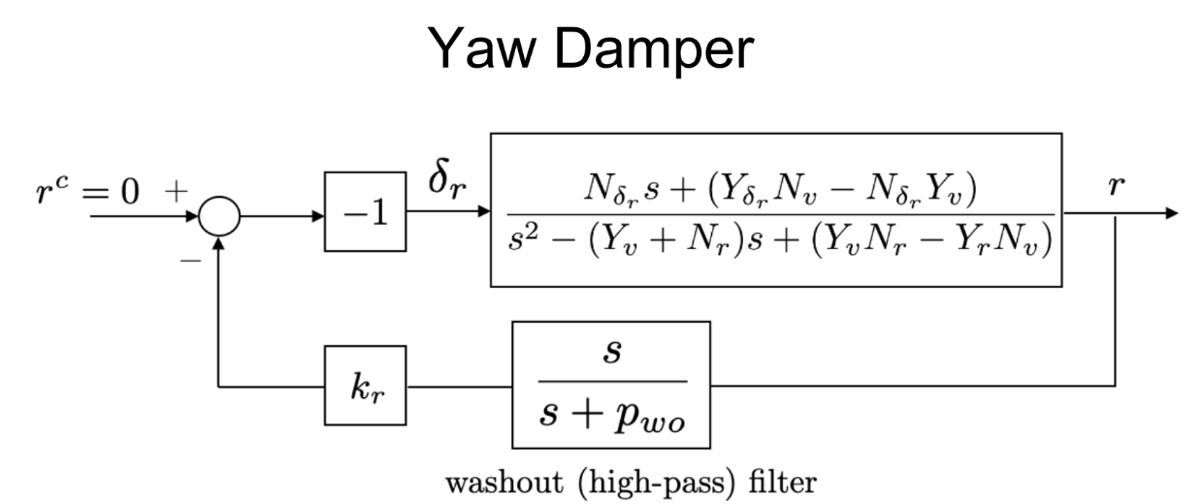
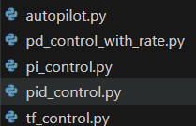
Implementing PID
Implemented the autopilot class which holds the “components” capable of control (Aileron, Yaw Damper, Throttle, etc.)
The autopilot class applies the appropriate controller to the component.
For instance, Throttle is controlled with PI while Roll is controlled with PD (+rate control).
Each of the controllers (PD, PI, PID, TF) is implemented with their unique control law called to each parameter in the Autopilot class.
Notes:
This is the end of old stuffs, new stuff strats with sensors

Slide 10
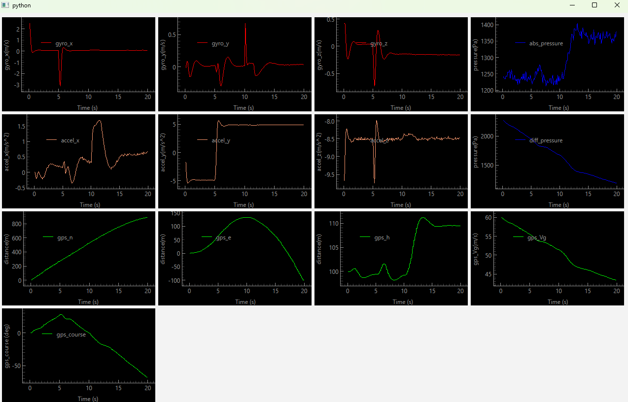
Sensors
We simulated:
Gyroscopes
Accelerometers
Magnetometers
Pressure sensors
GPS
Given the state, we simulate what those sensors would output and add noise
Sensor outputs are read by Kalman filter to provide estimate of state

Slide 11
Kalman Filter
Kalman filter estimates state based on sensor measurements, model propagation
Model differential equations for how state changes over time
Model equations for what sensors should output given aircraft state
When a new sensor measurement comes in, update the estimated state given the measurement, taking into account the expected variance of the sensors.
Notes:
Every part of this project is about first creating something, then made it realistic
Started with a rigid body, then added aerodynamics
Started with PID control, then added Kalman Filter and sensors
Show room model

Slide 12
Final Project: Cessna 172

Slide 13
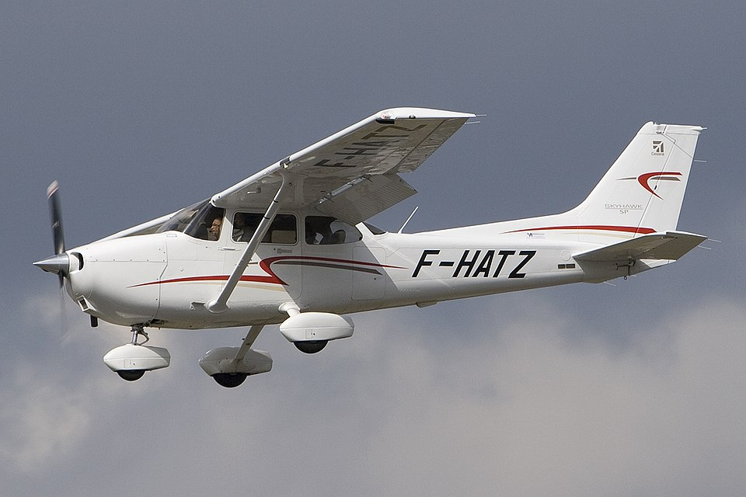
Changes necessary for Cessna
Change stability derivatives
Change engine model
Retune PID
Retune Kalman filter
Image source: https://upload.wikimedia.org/wikipedia/commons/thumb/a/ae/Cessna_172S_Skyhawk_SP%2C_Private_JP6817606.jpg/960px-Cessna_172S_Skyhawk_SP%2C_Private_JP6817606.jpg

Slide 14
Stability derivatives + physical parameters
Found source:
Kasnakoğlu, Coşku. (2016). Investigation of Multi-Input Multi-Output Robust Control Methods to Handle Parametric Uncertainties in Autopilot Design. PLOS ONE. 11. e0165017. 10.1371/journal.pone.0165017.
Just requires changing all aircraft parameters in aerosonde_parameters.py

Slide 15
Engine model
Engine was previously modeled as DC electric motor with formulas to calculate force and torque from RPM, which depends on windspeed, depends on voltage etc…
Complicated analysis specific to DC motor
We found a source for a basic engine model: Lutze, F. H. (n.d.). Thrust models [Supplemental course notes]. Virginia Tech Department of Aerospace and Ocean Engineering. https://archive.aoe.vt.edu/lutze/AOE3104/thrustmodels.pdf

Slide 16
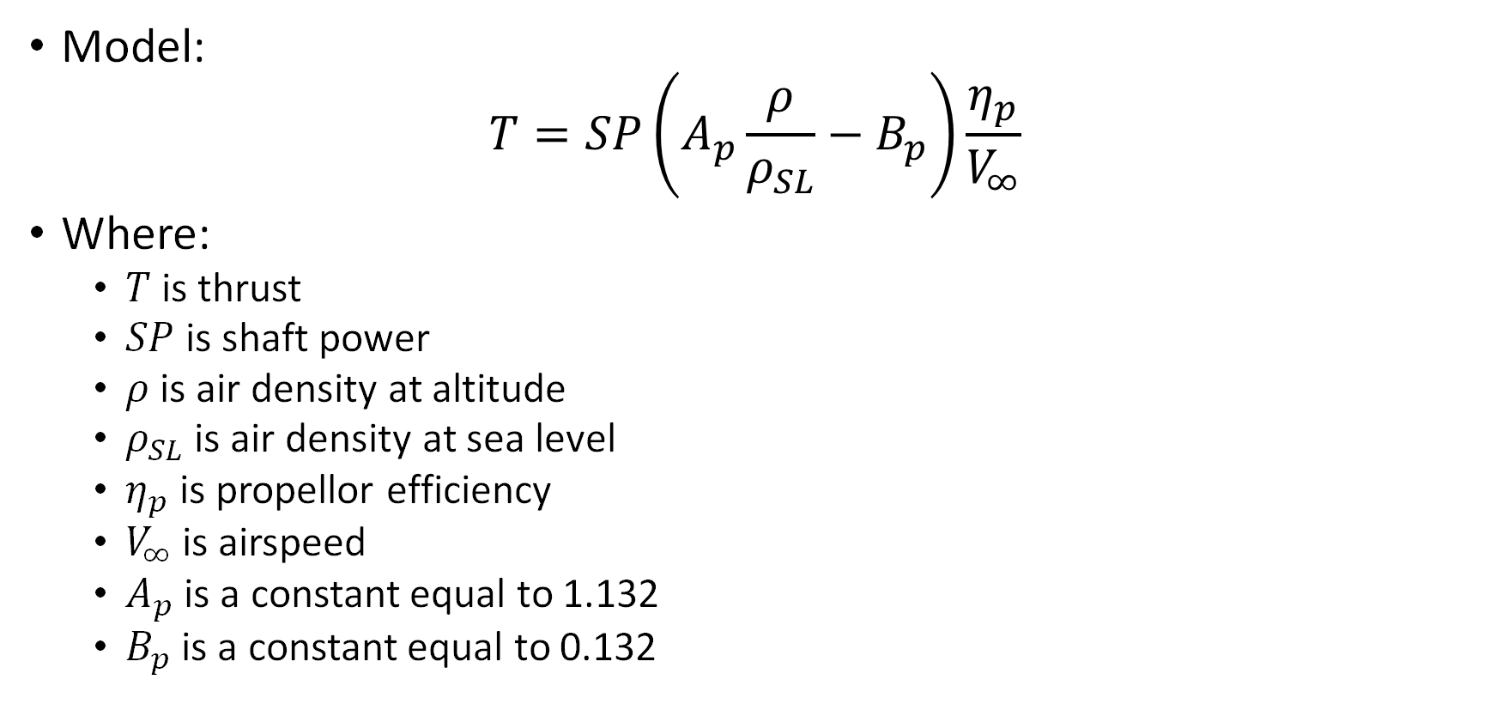
Engine Model (cont.)
Model:
$$T=SP\left(A_{p}\frac{ρ}{ρ_{SL}}−B_{p}\right)\frac{η_{p}}{V_{∞}}$$
Where:
$T$ is thrust
$SP$ is shaft power
$ρ$ is air density at altitude
$ρ_{SL}$ is air density at sea level
$η_{p}$ is propellor efficiency
$V_{∞}$ is airspeed
$A_{p}$ is a constant equal to 1.132
$B_{p}$ is a constant equal to 0.132

Slide 17
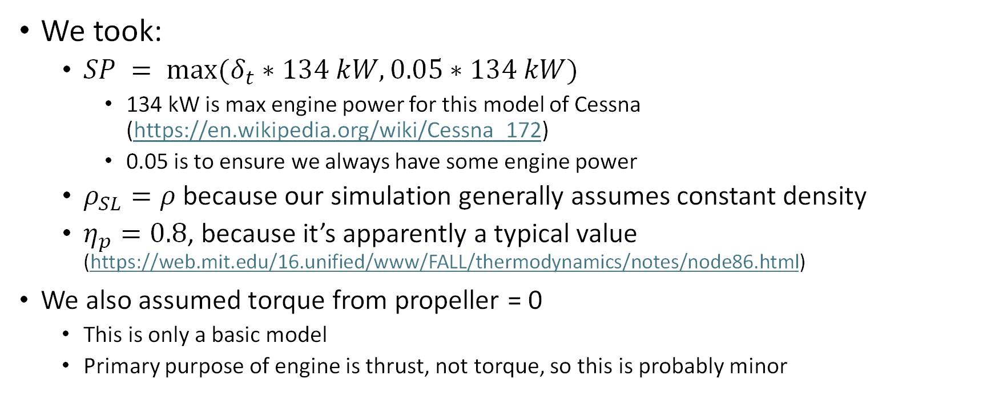
Engine Model (cont.)
We took:
$SP = max(δ_{t}∗134 kW, 0.05∗134 kW)$
134 kW is max engine power for this model of Cessna (https://en.wikipedia.org/wiki/Cessna_172)
0.05 is to ensure we always have some engine power
$ρ_{SL}=ρ$ because our simulation generally assumes constant density
$η_{p}=0.8$, because it’s apparently a typical value (https://web.mit.edu/16.unified/www/FALL/thermodynamics/notes/node86.html)
We also assumed torque from propeller = 0
This is only a basic model
Primary purpose of engine is thrust, not torque, so this is probably minor

Slide 18
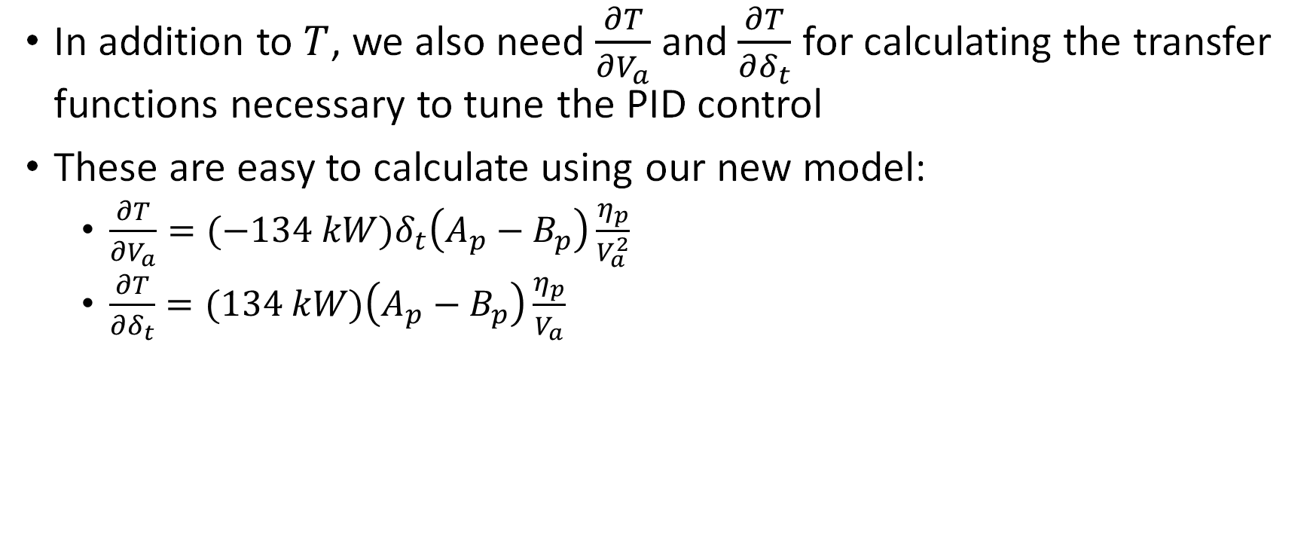
Engine Model (cont.)
In addition to $T$, we also need $\frac{∂T}{∂V_{a}}$ and $\frac{∂T}{∂δ_{t}}$ for calculating the transfer functions necessary to tune the PID control
These are easy to calculate using our new model:
$\frac{∂T}{∂V_{a}}=(−134 kW)δ_{t}\left(A_{p}−B_{p}\right)\frac{η_{p}}{V_{a}^{2}}$
$\frac{∂T}{∂δ_{t}}=(134 kW)\left(A_{p}−B_{p}\right)\frac{η_{p}}{V_{a}}$

Slide 19
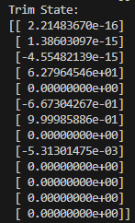
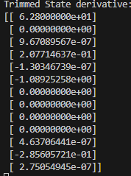
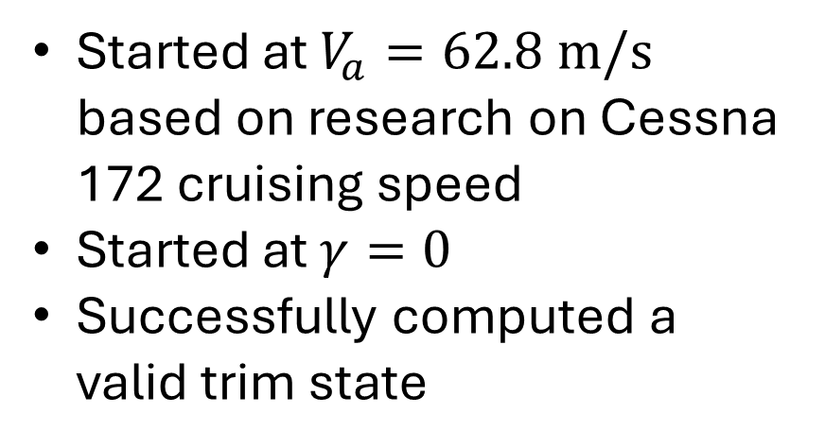
Trim Condition
Started at $V_{a}=62.8 m/s$ based on research on Cessna 172 cruising speed
Started at $γ=0$
Successfully computed a valid trim state
Notes:
Q_dot is zero here

Slide 20
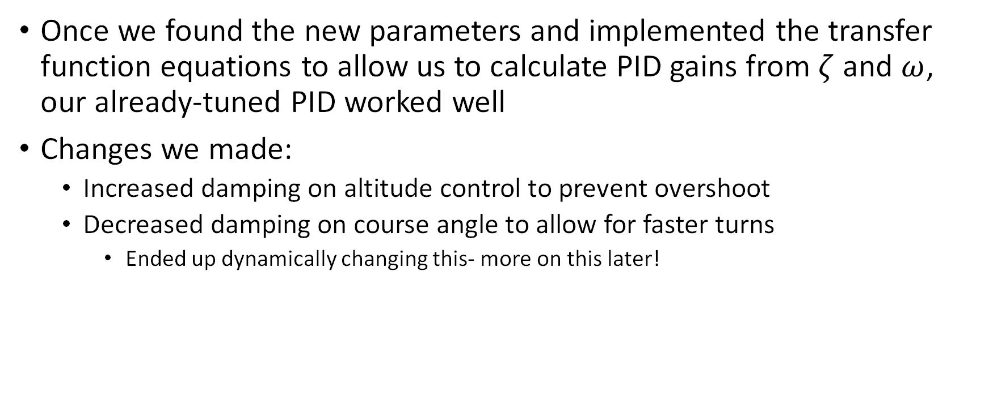
PID Tuning
Once we found the new parameters and implemented the transfer function equations to allow us to calculate PID gains from $ζ$ and $ω$, our already-tuned PID worked well
Changes we made:
Increased damping on altitude control to prevent overshoot
Decreased damping on course angle to allow for faster turns
Ended up dynamically changing this- more on this later!

Slide 21
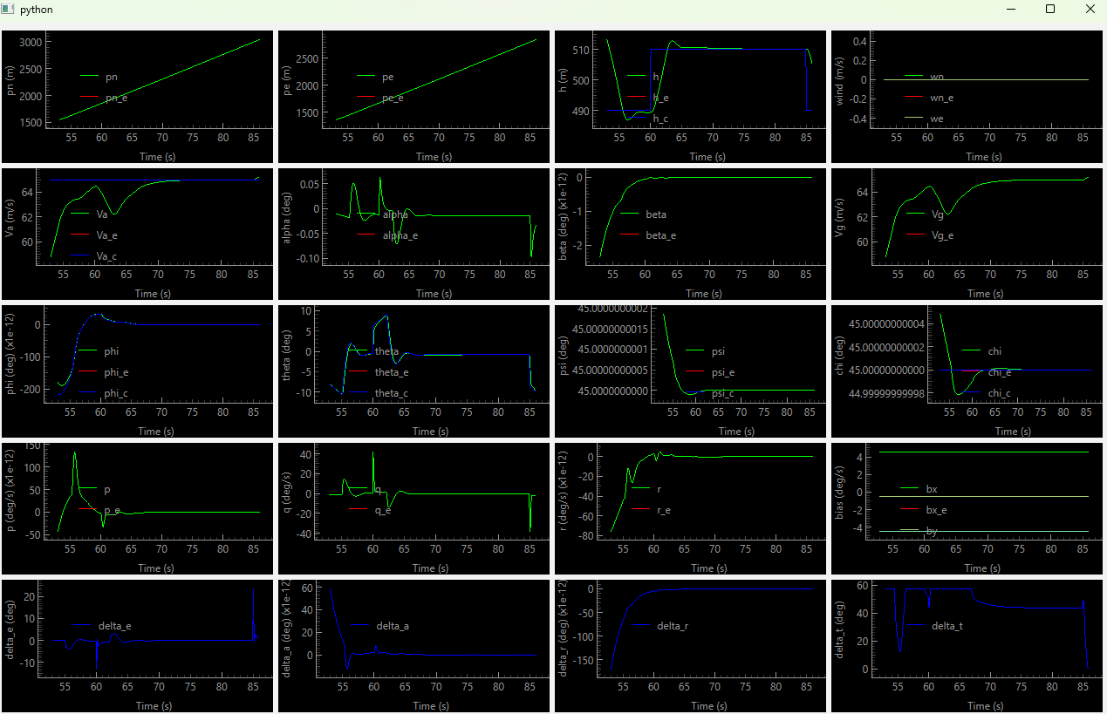

Slide 22
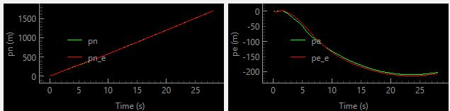
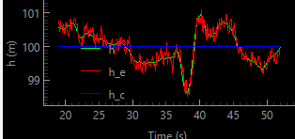
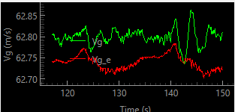
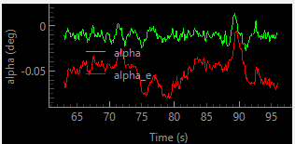
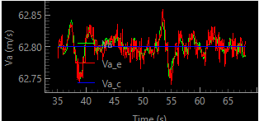
Kalman filter tuning
We had some bugs in our original Kalman filter which we ironed out.
Found a mistake in Beard’s code! A vector was in the wrong order
Once these were fixed, Kalman filter worked well

Slide 23
Realistic test scenario
We also implemented routines to automatically test our autopilot and observer in a common scenario- takeoff, cruise, turning, and landing.
This tests how our autopilot performs while transitioning between commands.

Slide 24
Takeoff
Implemented simple ground interaction:
if mav.true_state.altitude <= 0.0:
mav.true_state.altitude = 0.01
mav._state[2] = 0.01
This is not realistic:
Doesn’t consider forces
No friction
Doesn’t prevent tipping
Good enough for our purposes

Slide 25
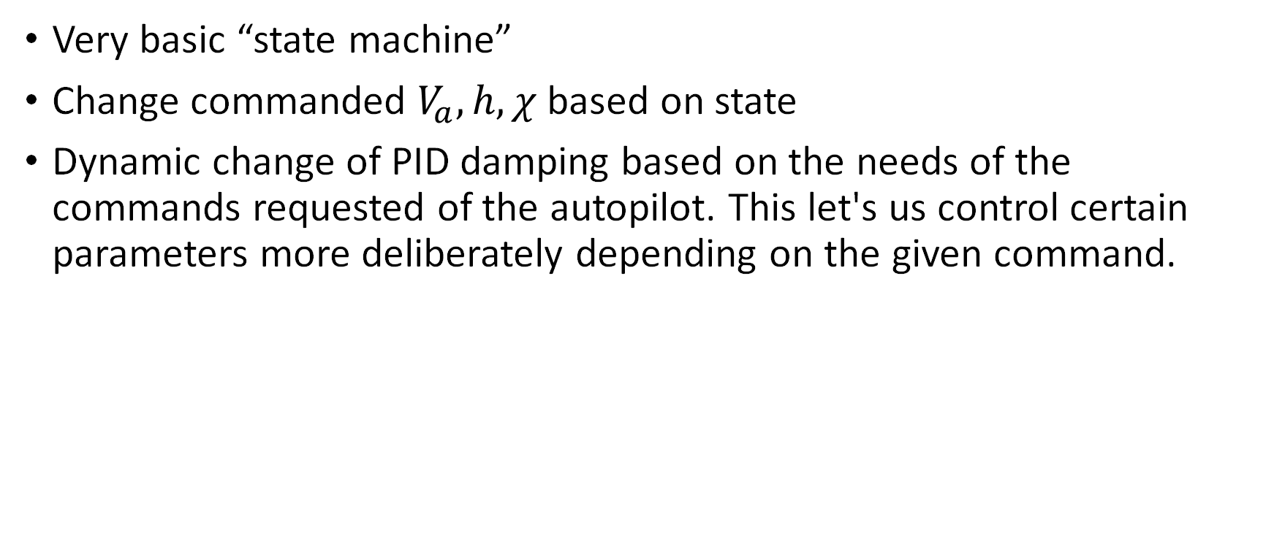
Autopilot structure
Very basic “state machine”
Change commanded $V_{a}, h, χ$ based on state
Dynamic change of PID damping based on the needs of the commands requested of the autopilot. This let's us control certain parameters more deliberately depending on the given command.
Accelerate
Speed condition met
Takeoff
Altitude conditions met
Cruise
Time passed
Turn
Course angle attained
Descend
Notes:
Mention

Slide 26
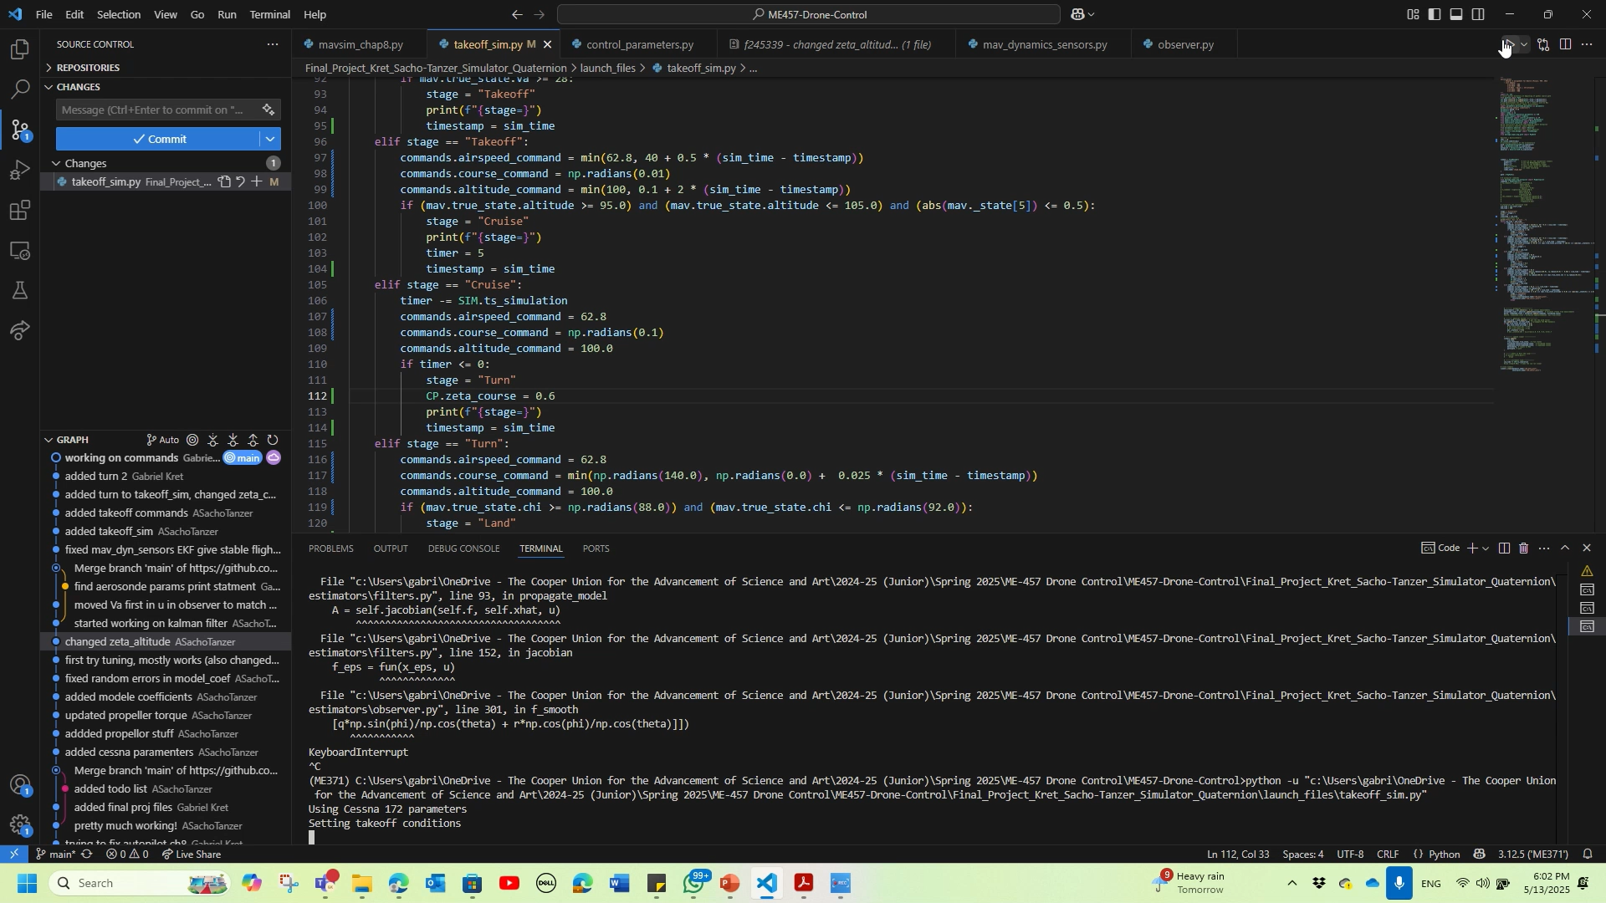
Autopilot demonstrations

Slide 27
Future improvements
Ground model is inaccurate
No friction, traction
No forces
Aircraft model is incomplete
No wheels
No airbrakes/flaps
No aerodynamic ground effect
Aerodynamic model is inaccurate at low speeds
Should be accurate from mid-acceleration to just before landing

